Slide 1
Object Oriented Modeling and Design with UML

Slide 2
Introduction
It is a new way of thinking about problems using models based on real world concepts.
The basic construct is object which combines both data structure and behavior(Operations) in a single entity.
Analysis model is built to abstract essential aspects of application domain which contains objects found in application, their properties and behavior.

Slide 3
Introduction
Design model is made to describe and optimize the implementation.
Implementation Finally the design model is implemented in a programming language, database or hardware.
Graphical notation is used for expressing object-oriented models.

Slide 4
What is object-oriented?
Software is organized as a collection of discrete objects that incorporate both data structure and behavior.
In general it includes- identity, classification, polymorphism and inheritance.
Object Oriented Programming Language
= Object Based Programming Language
+ Inheritance + Dynamic Binding

Slide 5
Characteristics of Objects
Identity
Classification
Polymorphism
Inheritance

Slide 6
Identity
Identity means that data is organized into discrete(isolated), distinguishable entities called objects.
Objects can be concrete(tangible) or conceptual(intangible).
In real world an object simply exist but within a programming language each object has a unique handle by which it can be uniquely referenced.
Each object has its own inherent identity.In other words,two objects are distinct even if all their attributes values(such as name and size) are identical.
They can be implemented by address, array index or unique value of an attribute

Slide 7
Classification
It means that objects with same data structure (attribute) and behavior (operations) are grouped into a class.
A class is an abstraction that describes important properties and ignores the rest.
Each object is said to be an instance of its class.An object has its own value for each attribute but shares the attribute names and operations with other instances of the class.

Slide 8
Polymorphism
It means that the same operation (i.e. action or transformation that the object performs) may behave differently on different classes.
An operation is a procedure or transformation that an object performs or is subject to.
Specific implementation of an operation by a certain class is called a method.

Slide 9
Inheritance
It is the sharing of attributes and operations among classes based on a hierarchical relationship.
Subclasses can be formed from broadly defined class.
Each subclass incorporates or inherits all the properties of its super class and adds its own unique properties.

Slide 10
Object-oriented development?
The theme is the identification and organization of application concepts, rather than final representation in a prog. Language.
OOD approach encourages software developers to work and think in terms of the application domain through most of the software engineering life cycle.
It is a conceptual process independent of a programming language until the final stage.

Slide 11
Object-oriented methodology
Here we represent a methodology for OOD and a graphical notation for representing OOD concept. The methodology consists of: -
Building a model of an Application
Design(Adding implementation details)
We call this approach the Object Modeling Technique.

Slide 12
Methodology Stages
Analysis:- Starting from a statement of the problem. Build a model of real word situation showing its important properties. Model will be Abstraction of what the desired system must do.
Design:- take high level decision about overall architecture, and the target is to organized system into sub-systems based on analysis and proposed architecture

Slide 13
Methodology Stages
Object design:- create a model based on analysis but also containing implementation details. The focus of this design is the data structure and the algorithms needed to implement each class. Object classes and relationship developed here.
Implementation:- here all classes and relationships are finally translated into programming language. It is important to follow good soft. Engg. Practice so that implemented system remain flexible and extensible.

Slide 14
FOUNDATIONAL CHARACTERISTICS OF AN OBJECT‑ORIENTED METHODOLOGY
Abstraction
Encapsulation or information hiding
Combining data and Behavior
Inheritance(sharing)
Polymorphism
Message communication
Associations
Reuse

Slide 15
Abstraction
It consists of focusing on essential aspects of an entity and ignoring accidental properties.
The goal is to isolate those aspects that are important for some purpose and suppress those aspects that are unimportant.
Abstraction must always for some purpose because the purpose determines what is and what is not important.
Many different abstractions of same thing are possible, depending on the purpose for which they are made.
A good model captures the crucial aspects of a problem and omits the others.
Focus on what an object is and does, not how to implement.

Slide 16
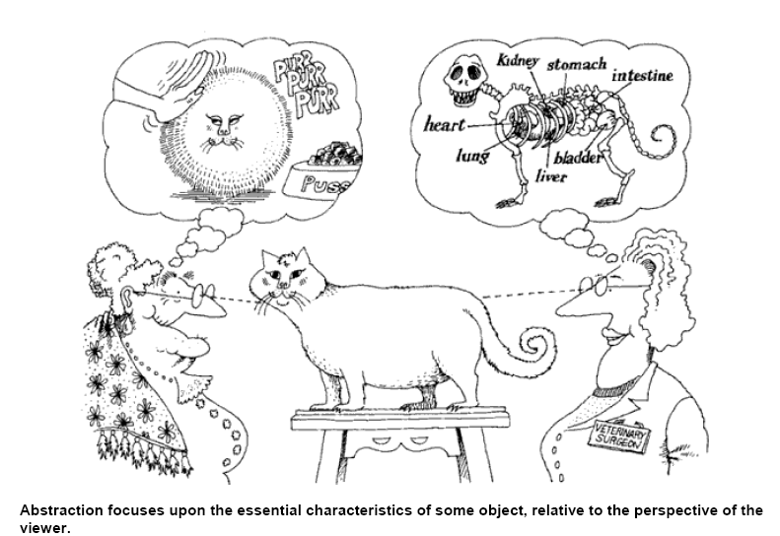
Abstraction

Slide 17
Encapsulation
Information hiding
Separating external aspects of an object which are accessible to other objects, from the internal implementation details of the object, which are hidden from other objects.
The implementation of an object can be changed without affecting the applications that use it.

Slide 18
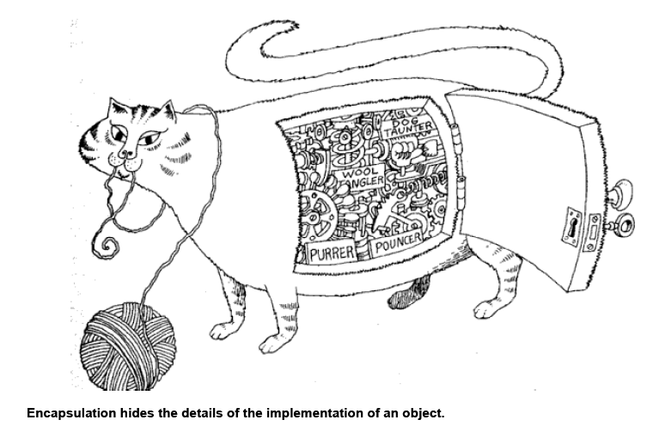
Encapsulation

Slide 19
Advantages of OOD……………
Used in developing Compilers, Graphics, UI, databases, Object oriented languages, CAD systems, simulations, etc.
Used to document existing programs that are ill-structured and difficult to understand.
Not reduces development time; it may take more time than conventional development because it is intended to promote future reuse and reduce downstream errors and maintenance.

Slide 20
Modeling
A model is an abstraction of something for the purpose of understanding it before building it.
The word model has 2 dimensions- a view of a system ( object, dynamic or functional) and a stage of development ( analysis, design or implementation)

Slide 21
Purposes of Modeling
Testing a physical entity before building it
Communication with customers
Visualization
Reduction of complexity

Slide 22
3 models
Class model
State model
Interaction model

Slide 23
Modeling
1) Class model
The class model describes the structure of the object, the relationship of one object with other objects, attributes and operations of the object.
The state and interaction models use the context of the class model.
The goal of the class model is to capture the concepts from the real worlds that are useful for your application
The class model is represented by the class diagrams. The classes in this diagrams define the attributes and operations of each object.

Slide 24
Modeling
2) State model
The state model is concerned operations of the object.
with the time and sequencing of the
On occurrence of the events the object change their state.
The state Model captures the control aspect of the system.
The state model is represented by State diagram. Each state diagram represents state and the event sequences.

Slide 25
Modeling
3) Interaction Model
Interaction model describes how one object collaborates with other in order to achieve behaviour of the system
The overall behaviour of the system can be represented with the help of state and interaction model.
The interaction model includes use case diagrams, sequence diagrams and Activity diagrams.
The use case diagrams show how to outsider actor interacts with the system to achieve functionality.
The sequence Diagram represents the objects that interact and the time sequence of their interaction
The activity Diagram represents flow of control among objects.

Slide 26
Introduction to class modeling
A class model captures the static structure of a system by characterizing the objects in the system, the relationships between the objects and the attributes and operations for each class of objects.
◆
Class model provides a graphical representation of a system and are used for communicating with customers.
◆

Slide 27
Class and Object Concept
Classes
Class is a group of objects having same attributes and operations, relationships and semantics.
The classes appear as common nouns or noun phrases.
Objects in a class share a common semantic purpose. For Example both the dog and cat have the properties like tail and legs and they belong to same class Animal.
Grouping the objects into corresponding classes make the design Abstract.
Objects
The main purpose of class model is to describe objects.
Object is an instance of a class.
The objects can be conceptual entities, real world entities, or important things from implementation point of view.
The objects are normally nouns. The choice of objects is done by judgements.
For Example: If a student is a class then Anuja, pooja and Kajal are the obUMjeL 1c1ts of the class students. Each student has its own name, roll no, and address.

Slide 28
Class Diagrams
◆
The class Model is represented by two types of diagrams:-
1) Class Diagrams
Class diagrams provide a graphic notation for modeling classes and their relationships thereby describing possible objects.
◆
◆
Useful for abstract modeling and designing actual programs.
◆
They are concise ,easy to understand
2) Object Diagrams
◆
Object diagrams shows individual objects and their relationship .
◆
A class diagram corresponds to an infinite set of object diagrams.

Slide 29
Continue….
#Notation used for class & object diagram:
→ For class diagram:-
Person
→For object diagram:-
Smith:Person
Mary:Person

Slide 30
Values and Attributes
◆
A value is a piece of data.
An attribute is a named property of a class that describes a value held by each object of the class.
◆
◆
E.g. Name,birthdate and weight are attributes of Person class.
- Color,modelyear and weight are att. Of Car class.
◆
Each attribute name is unique within a class.
◆
So Person and Car class have attribute called weight.

Slide 31
Values and Attributes continue….
# Example:-
→List att. In the second compartment of the
class box.
Person
name: string bdate:date
Class Name
Attributes
Smith:Person
Mary:Person
name: "Joe Smith” b’date:21/10/1983
name: “Mary Sharp” b’date:16/03/1953

Slide 32
Operations and Methods
◆
Objects have procedures or functions which are called as operations.
◆
All the objects in the same class share the common set of operations.
For Example- The class Shape can have various objects such as rectangle, triangle or square having common operations such as move, draw, print.
◆
◆
A method is the implementation of an operation for a class.
When an operation has methods on several classes it is important that the methods all have the same Signature.
◆
◆
Signature means the number and types of arguments and type of return value.
◆
e.g. print should not have fileName as an argument for one method filePointer
for another.
UML 16

Slide 33
Operations and Methods continue…
→Feature is a generic word for either an attribute or operation.
→UML notation is to list operations in the third compartment of the class box.
#Examples:-
Person
name: string b’date:date
changeJob changeAddress
File
fileName sizeInBytes lastUpdate
print
GeometricObject
color position
move(delta : Vector) select(p:Point):Boolean rotate(in angle:float=0.0

Slide 34
Summary of Notation for classes
→The attribute and operation compartments are optional.
→A missing attribute / operation compartment means that attributes / operations are unspecified.
→An empty compartment means attributes/operations are specified and that are none.
ClassName
attName1:dataType1=defaultValue1 attName1:dataType1=defaultValue1
. . .
operationName1(argList1) : resultType1 operationName2(argList2) : resultType2
. . .

Slide 35
Link and Association
◆
A link is a physical or conceptual connection among objects.
◆
Most link relate two objects but some links relate three or more objects.
◆
e.g. Smith works for simplex company.
◆
A link is an instant of an association.
◆
An Association is a description of a group of links with common structure and common
semantics.

Slide 36
Link and Association continue…
◆
An association connects related classes and it is also denoted by a line. (with
multiple line segments)
◆
It is good to arrange the classes in an association from left to right ,if
possible.
◆
The associations and links often appears as verbs in problem statements.

Slide 37
Link and Association continue…
Person | WorksFor | Company
 | * *
name |  | name
Class diagram
→ For example,
a person
John:Person
name=“john”
GE:Company
Mary:Person
name=“Mary”
Name=“GE”
Sue:Person
IBM:Company
Name=“IBM”
Object diagram
Name=“Sue”
Jeff:Person
Name=“jeff”

Slide 38
Multiplicity
◆
Multiplicity specifies the number of instances of one class that may relate
to a single instance of an associated class.
◆
UML diagrams explicitly list multiplicity at the end of the association lines.
◆
Multiplicity Indicators
Exactly one | 1
Zero or more (unlimited) | * (0..*)
One or more | 1..*
Zero or one (both inclusive) | 0..1
Specified range | 2..4
Multiple, disjoint ranges | 2, 4..6, 8

Slide 39
Multiplicity Continue…
 | HasCapital | CapitalCity
Country
 | 1 1
 |  | name
name
Class diagram
 | HasCapital | Ottawa:CapitalCity
Canada:Country
 |  | Name=“Ottawa”
Name=“Canada”
HasCapital
Paris:CapitalCity
France:Country
Name=“France”
Name=“Paris”
Object diagram

Slide 40
Association End Names
◆
If we consider one to many association then it has two ends-an end
with a multiplicity of “one” and an end with a multiplicity of “many”.
◆
We can also give the name to both the ends.
◆
Association end names often appear as nouns in problem descriptions.
◆
Example
Person
employee
WorksFor
employer
Company
*
0..1

Slide 41
Association End Names Continue…
◆
Association end names are necessary for associations between two
objects of the same class.
◆
For example container and contents distinguish the two usage of
Directory class.
owner 1
*
0..1 container
User
Directory
authorizedUser
*
*
* contents

Slide 42
ordering
If order of objects required
Indicated by writing “{ordered}” next to multiplicity dot for the role.
window
{ordered}
screen
Visible-on
Ordered sets in an association

Slide 43
Association Classes
The abstract class is a class that allows the association to be a class itself.
When two classes are related with each other by an association link, then the association itself can have attributes and operations
◆
Hence, association can be represented by a class.
The UML notation for an association class is a box attached to the association by a dashed line.
/etc/abc.txt read John
◆
File | * * | User
AccessibleBy
accessPermission
UML 28

Slide 44
Qualified Associations
◆
A qualified association is an association in which an attribute called the
qualifier disambiguates the objects for a “many” association end.
◆
possible to define for one-to-many and many-to-many asso.
A qualifier selects among the target objects, reducing multiplicity from “many” to “one”.
◆
◆
Example:- A bank services multiple accounts.

Slide 45
Qualified Associations Continue…
Bank
a/cNo.
1
Qualifier
0..1
Bank
 | 1 *
Account
a/cNo.
Account
Qualified
Not qualified

Slide 46
Generalization and Inheritance
◆
Generalization is the relationship between a class (super class)
and one or more variations of the class (subclasses).
Super Class
Super Class (Base class)
◆
Provides common functionality and data members
Subclass (Derived class)
…
◆
Inherits public and protected members from the super class
◆
Can extend or change behavior of super class by overriding
methods
Subclass
Overriding
UML 31
◆
Subclass may override the behavior of its super class

Slide 47
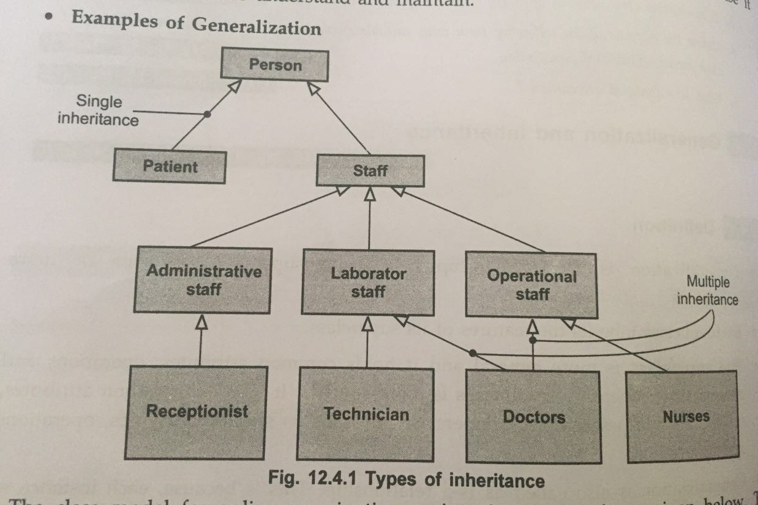
Generalization and Inheritance Continue…
→A large hollow arrowhead denotes generalization.

Slide 48
Figure
color
centerPosition penThickness
penType
Diagram
1
*
name
move select rotate display
dimensionality
ZeroDimensional
OneDimensional
TwoDimensional
orientation
orientation fillType
scale
scale fill
Point
Line
Arc
Spline
Polygon
Circle
endPoints
radius startAngle arcAngle
controlPts
numOfSides vertices
diameter
display
display
display
display rotate
display
display

Slide 49
Generalization – advantages
◆ Polymorphism
◆ Find common characteristics among classes
◆ Define hierarchies
◆ Reuse of the code

Slide 50
Aggregation
It is a part-of relationship
It has transitivity property i.e. A is part of B and B is part of C then A is part of C.
It is anti symmetric i.e. if A is a part of B then B is not a part of A.
Aggregation is a special form of association.

Slide 51
Aggregation
Aggregation is drawn like Association except that a small diamond indicates the assembly end of the relationship.
document
paragraph
sentence
Aggregation

Slide 52
Aggregation
It is a form of association in which an aggregate object is made of components.
Components are part of aggregate.
Aggregate is inherently transitive i.e. an aggregate has parts which may in turn have parts.

